Slide 1




Generative Artificial Intelligence
Paul Dubois
Info@Lèze

Slide 2
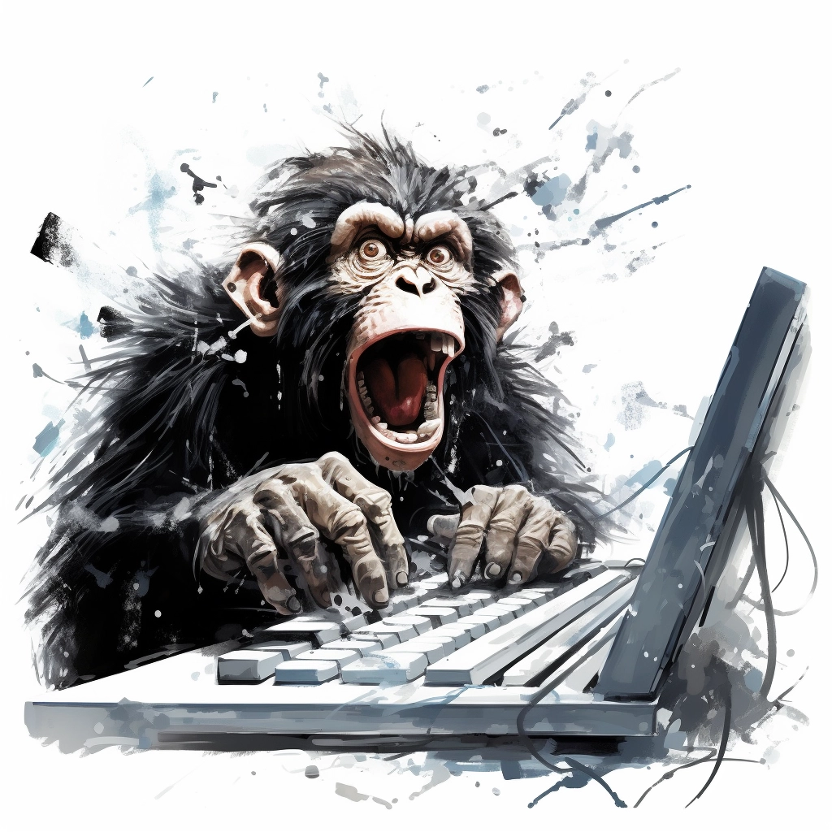
Creating *new* Words

Slide 3
Predict letters

Slide 4
Generator vs Discriminator

Slide 5
Denoising

